Slide 1
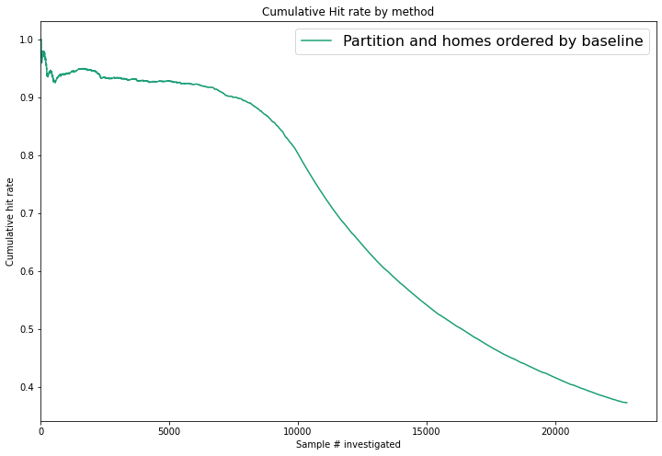
22 x 22 Partitioning

Slide 2
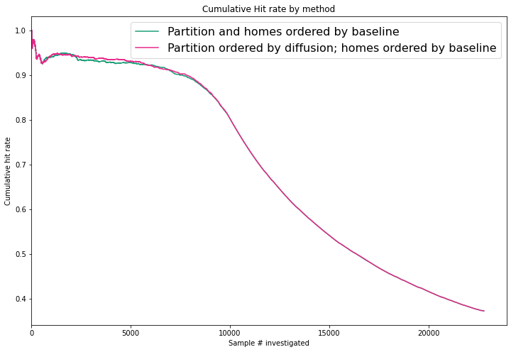
22 x 22 Partitioning

Slide 3
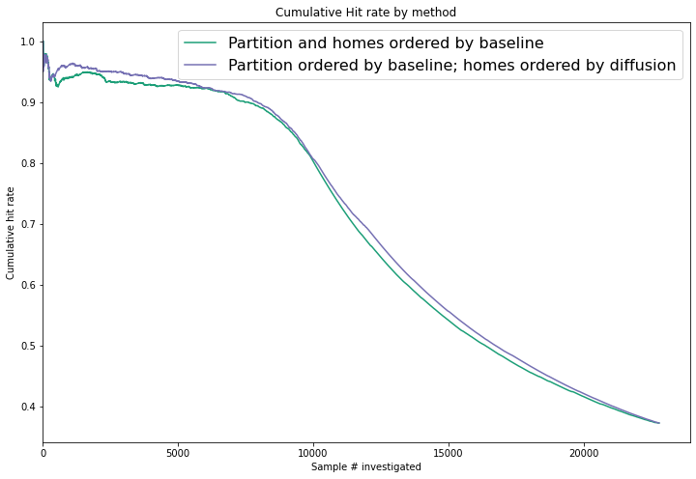
22 x 22 Partitioning

Slide 4
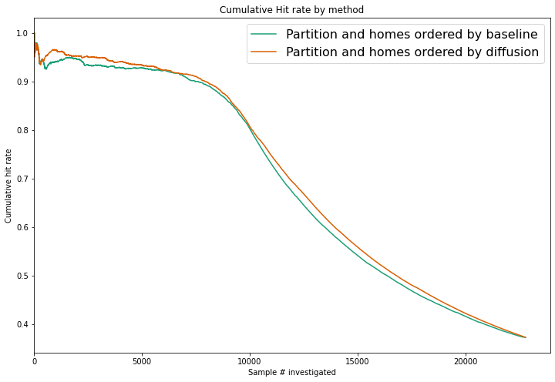
22 x 22 Partitioning

Slide 5
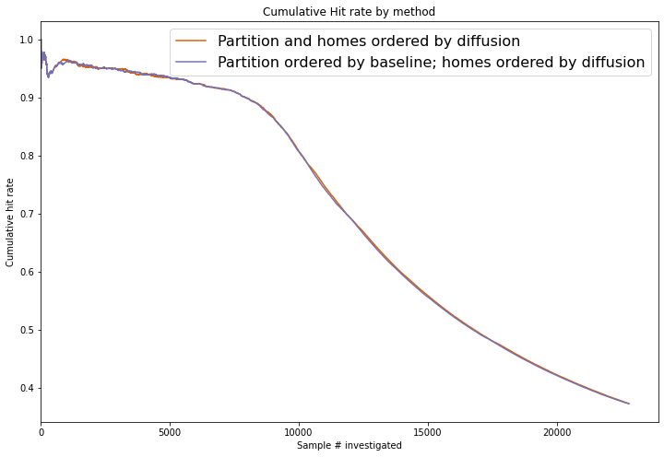
22 x 22 Partitioning

Slide 6
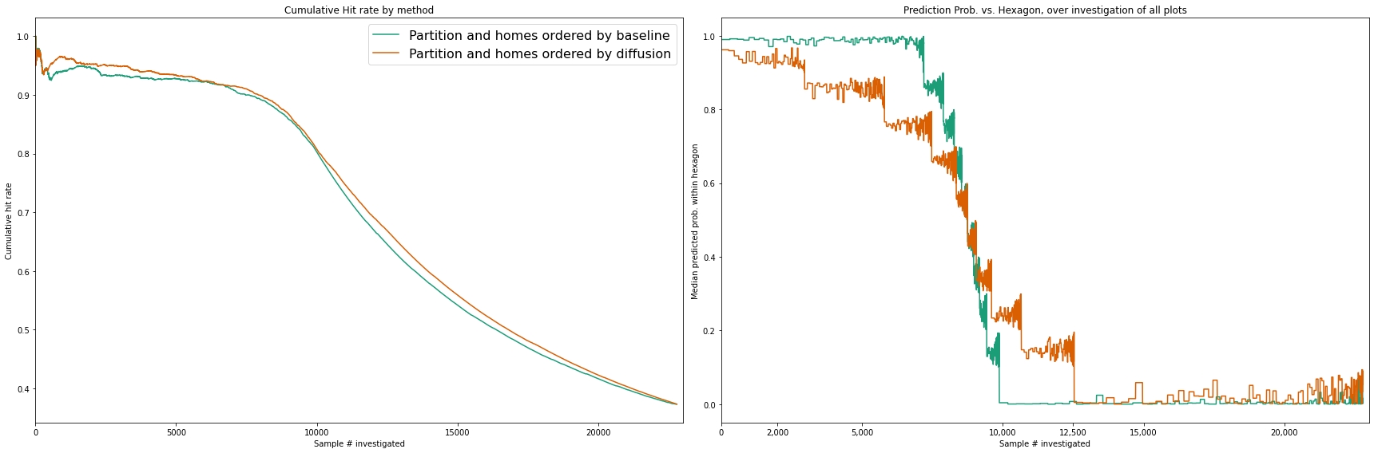
What is going on?

Slide 7
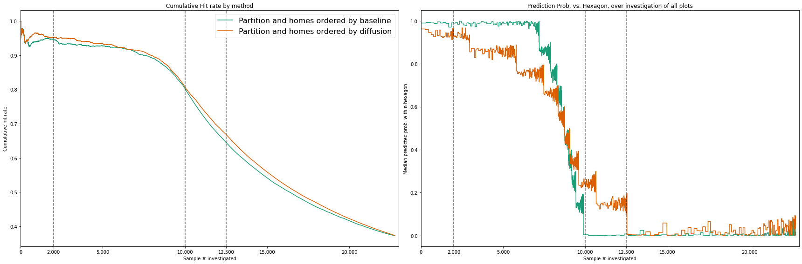
What is going on?

Slide 8
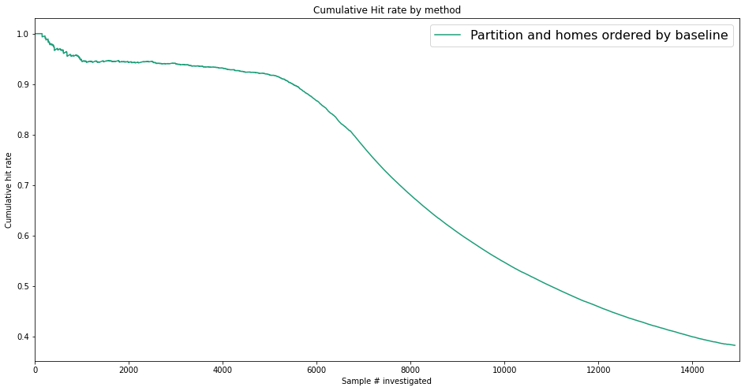
Hex Size = 99

Slide 9
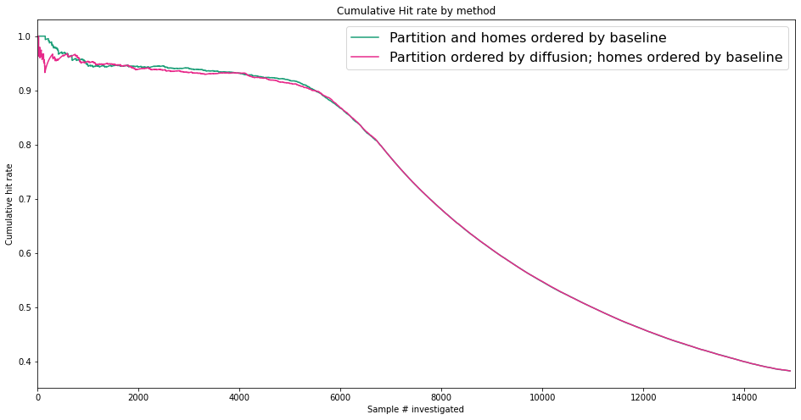
Hex Size = 99

Slide 10
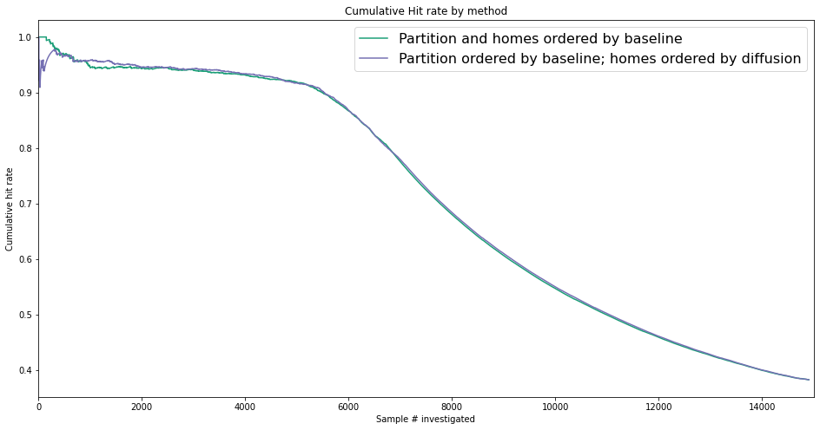
Hex Size = 99

Slide 11
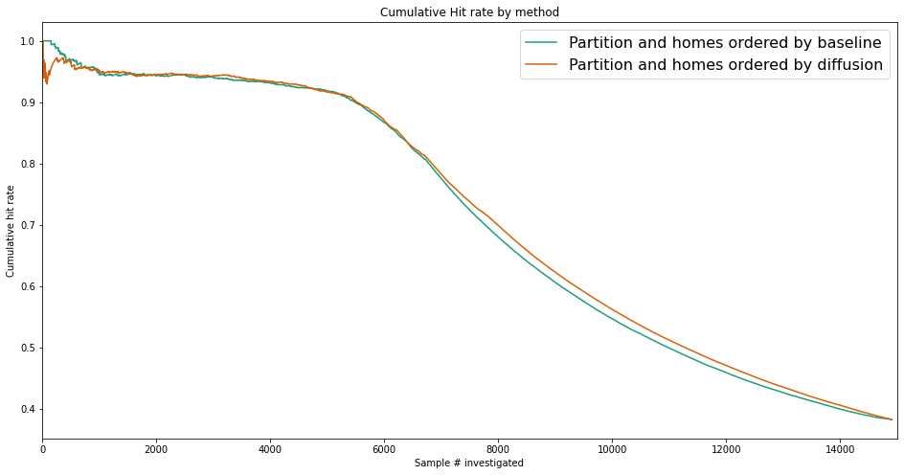
Hex Size = 99

Slide 12
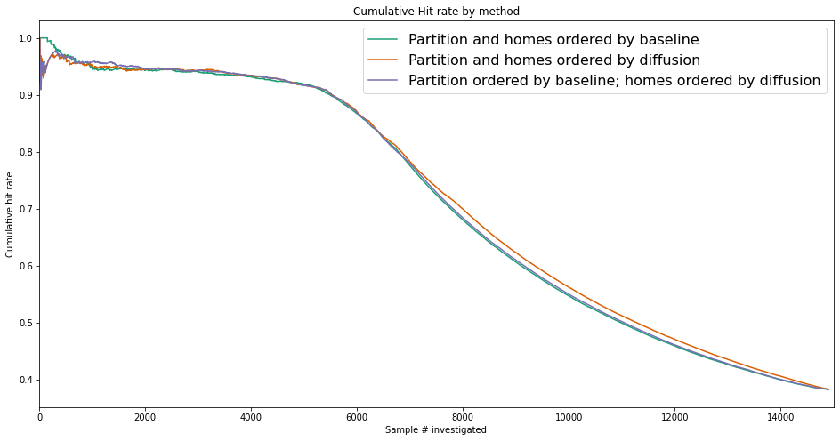
Hex Size = 99

Slide 13
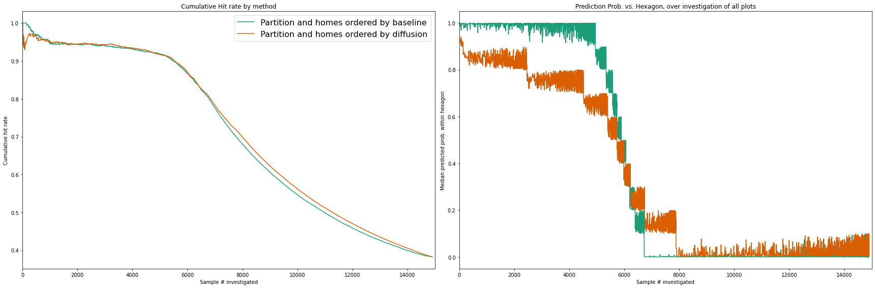
Hex Size = 99

